Slide 1

Indian Institute of Technology Guwahati Department of Civil Engineering Dam safety by satellite remote sensing
SUBMITED BY- MANISH BHAGAT ROLL NO - 234104617 SUBMITED TO – Dr. Subashisa Dutta ( Professor Water Resources Engineering and Management )

Slide 2
CONTENT
RESEARCH OBJECTIVE
InSAR – RADAR
SAR INTERFEROMETRY EXAMPLE
MULTI‑TEMPORAL SAR INTERFEROMETRY TECHNIQUES
STUDY AREA
CONCLUSION

Slide 3
RESEARCH OBJECTIVES
Examining the Dam's:
Using advanced satellite imaging technology, the movement pattern of a dam or reservoir rim over time can be monitored .
SATELLITE DATASET
InSAR(Interferometric synthetic aperture radar )
DInSAR(Differential SAR Interferometry)

Slide 4
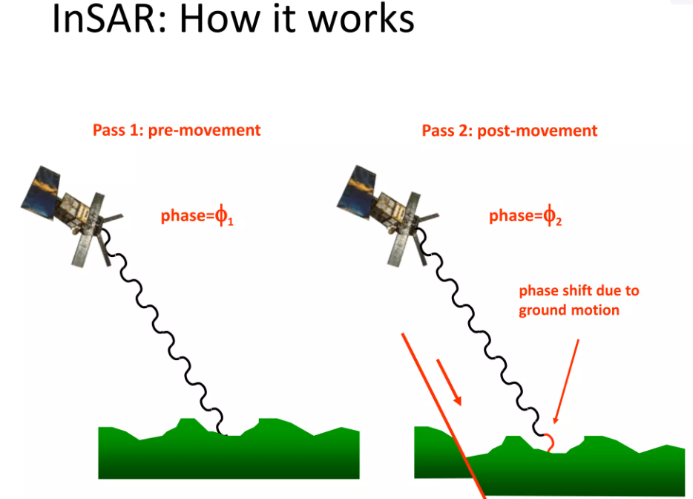
InSAR - RADAR
Interferometric synthetic aperture radar (InSAR) is a technique used to measure ground displacement.
Synthetic aperture radar (SAR) satellites actively emit microwave radiation towards the Earth’s surface and measure the portion of it that returns.
By comparing synthetic aperture radar measurements from two different dates, InSAR produces a measurement of the change in the ground position between the two dates.
By comparing observations from many dates, the movement pattern of a dam or reservoir rim over time can be obtained.
Figure Reference- IIRS ISRO Digital Learning program

Slide 5
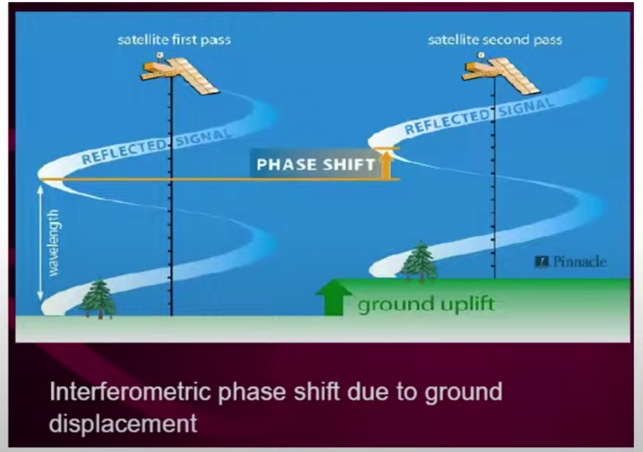
AMPLITUDE AND PHASE OF ECHO RECORDED AT THE SATELLITE
Radar signal has two component
Amplitude – provide data about ground , is there any vegetation or mountain, just like optical imagery.
Phase- it give idea about change of ground displacement , deformation in land over a time, Phase is a function of the distance from the satellite to the ground.
Figure Reference- IIRS ISRO Digital Learning program

Slide 6
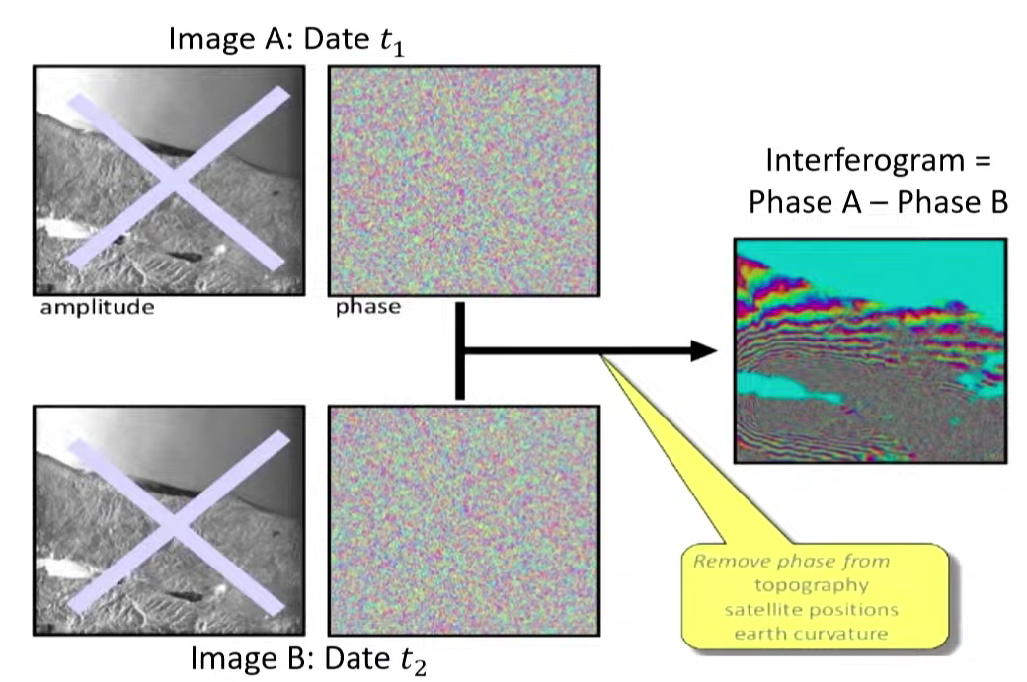
SAR INTERFEROMETRY EXAMPLE
An “interferogram” is a complex image :
Its magnitude related to correlation.
Its phase is related to geometry difference.
Displacement
Velocity
Acceleration
Figure Reference- IIRS ISRO Digital Learning program

Slide 7
MULTI‑TEMPORAL SAR INTERFEROMETRY TECHNIQUES
Differential SAR Interferometry
Classical DInSAR
Small Baseline Subset (SBAS)
Persistent Scatterer Interferometry (PSI)
Analysis of Single interferogram
Wide Area (with gaps)
Discrete Period
Required a suitable and accurate DEM .
Wide Area With lot of gaps
Short or long time series
Require multi-looked interferograms.
Point-point with high density
No limit of base line
Long time series

Slide 8
SATELLITE - SENTINEL-1 , TerraSAR-X, COSMO-Skymed
Open data policy are the European Space Agency’s twin sentinel-1A and sentinel-1B satellites.
They have data since 2014 and 2016,
two more sentinel-1 satellites (1C and 1D) are in development to ensure continuity into the future (ESA, 2015).
Why Sentinel Satellite
High-Precision Monitoring Sentinel-1 InSAR can detect ground movements at a millimetre scale, crucial for identifying early signs of instability.
Remote Sensing Capability
InSAR technology allows for continuous monitoring of large and remote areas, providing data without the need for physical presence on-site.
Cost-Effective Solution
Using satellite-based monitoring can reduce the cost and logistical challenges associated with ground-based monitoring systems.

Slide 9
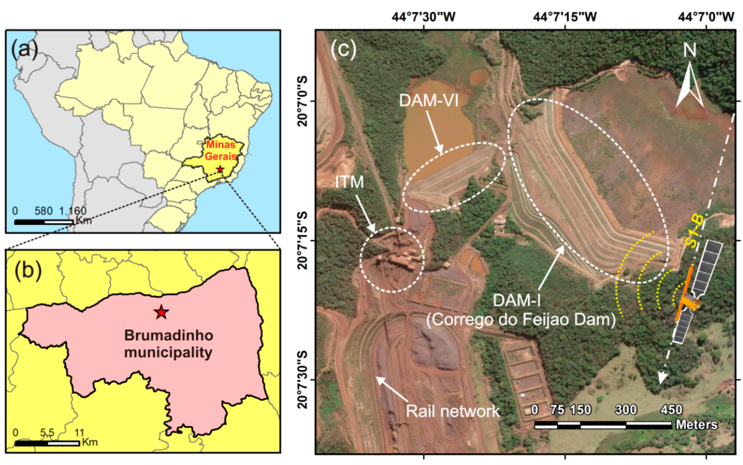
STUDY AREA 1
Figure 1. (a) Study area location in Minas Gerais state/Brazil; (b) Location of Paraopeba Iron Complexvin the Brumadinho municipality; (c) Paraopeba Iron Complex showing tailings Dam I and hydric Dam VI, ancillary mining structures such as ore treatment installation (ITM), rail network, access roads, and a Sentinel-1B descending orbit ground track.

Slide 10
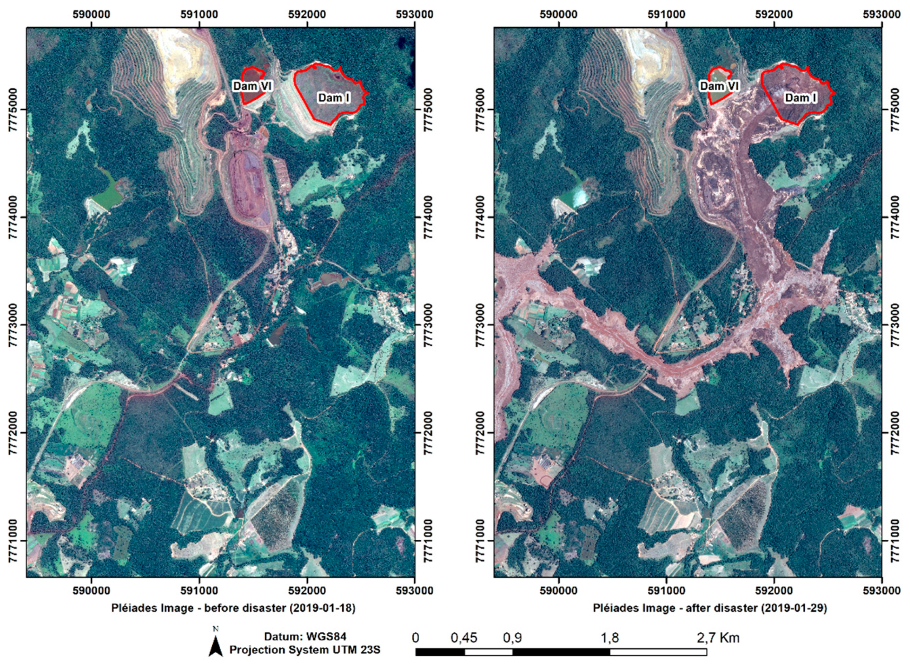
STUDY AREA
Figure 2. Pleiades satellite images taken just before and after the tragedy, showing the water from Dam-VI, the tailings from Dam-I, and the Corrégo do Feijão stream

Slide 11
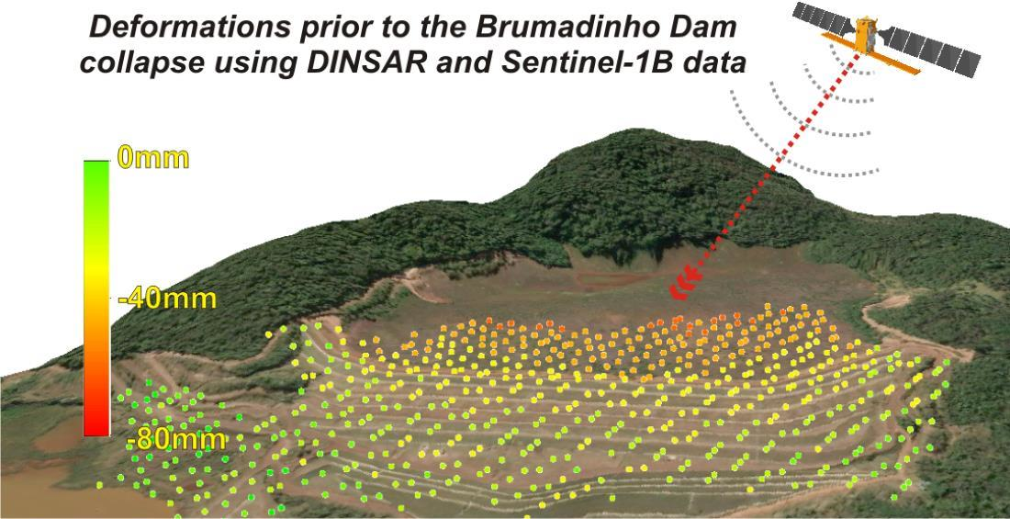
STUDY AREA

Slide 12

METHODOLOGY
Persistent Scatterer SAR Interferometry (PSInSAR)
1.DInSAR Interferometry
Small Baseline Subset (SBAS)
2.Topographic phase removal
WorldDEM Digital surface Model(DSM)
(Use for removing topographic phase component)
3.Data Analysis- SBSB and PSInSAR
4.Temporal Detection- Multi-temporal satellite acquisition

Slide 13
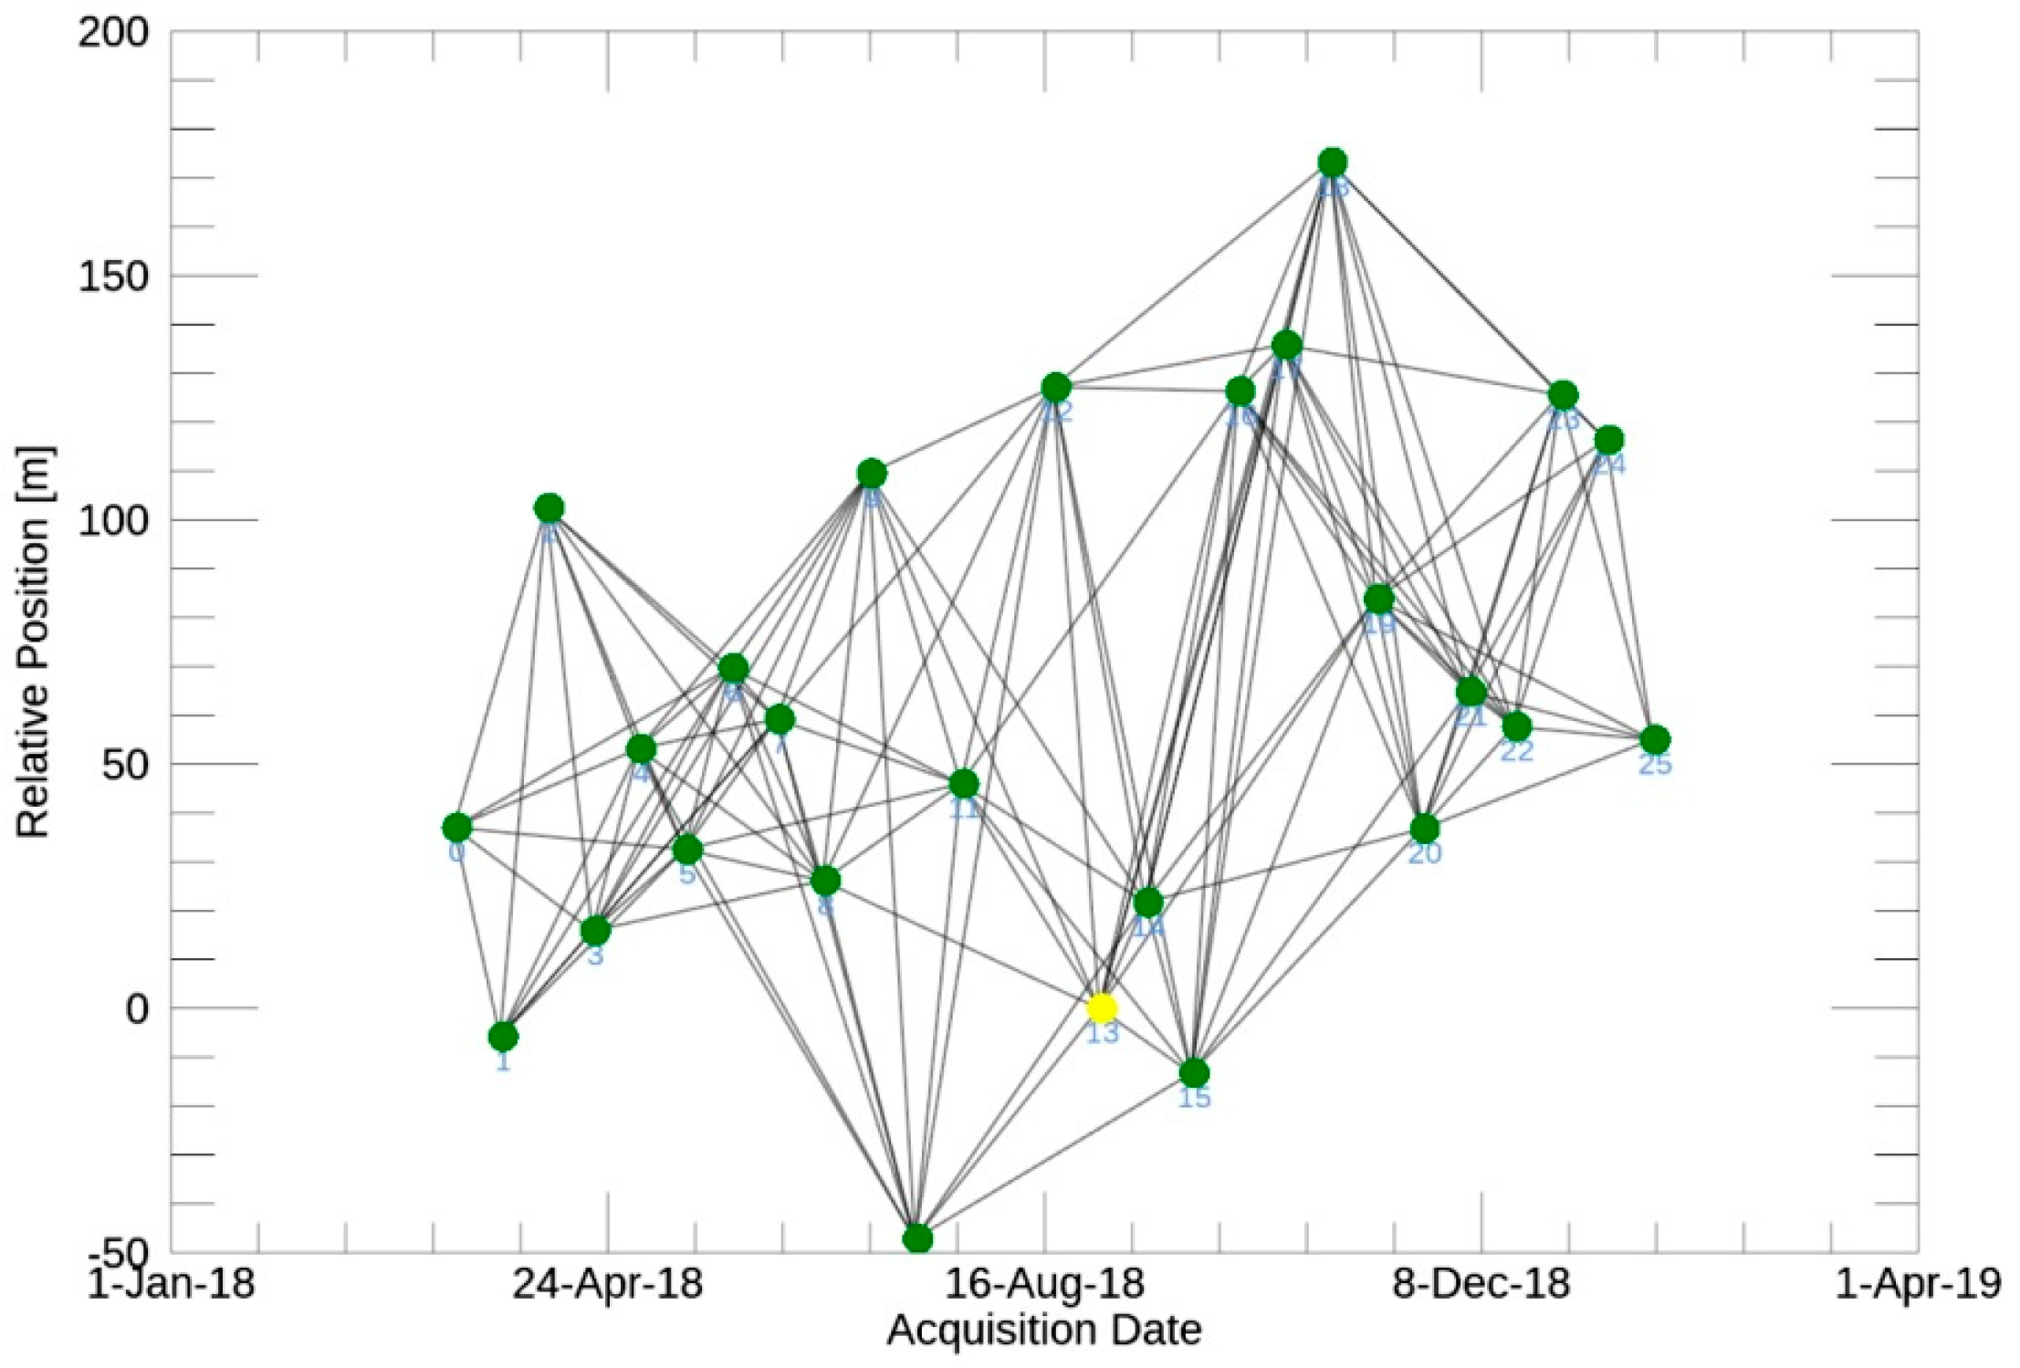
SMALL BASELINE SUBSET (SBAS)
In this method drawback of PSI is minimized because temporal gaps are small and hence temporal decorrelation is automatically minimized similarity between signal enhanced and accuracy measurement also enhanced .
Figure 2. Interferometric pairs (solid lines) chose for SBAS (Small BAseline Subset) analysis; green dots correspond to the S1-B scenes and yellow dot corresponds to the reference scene for the co-registration (31 August 2018)

Slide 14
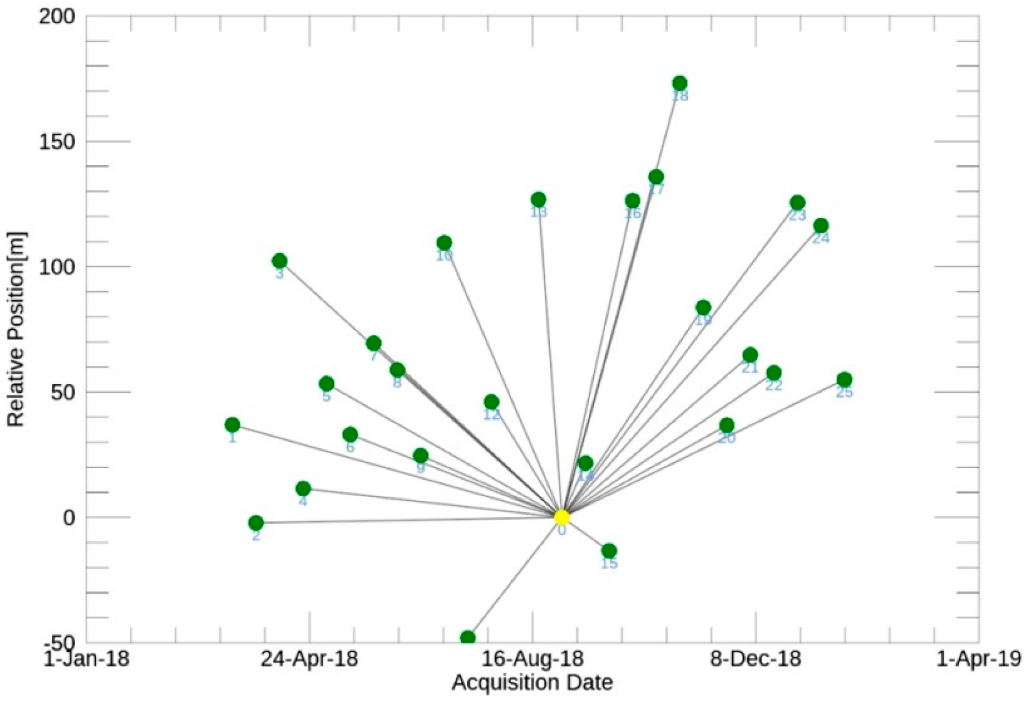
PERSISTENT SCATTERER INTERFEROMETRY (PSI)
Every dot is image and here middle image is master image and line is showing pair and line is showing temporal gap over a period of time.
Suppose we have any number of images we can generate numbers of pair using this we can make time series analysis.0
If temporal gap is to large then dissimilarity between these two image there it means the temporal decorrelation can’t be handled in case of the PSI .
Star network.
Figure 3. Interferometric pairs selected for PSI (Persistent Scatterer Interferometry) analysis; green
dots correspond to the S1-B scenes and yellow dot corresponds to the reference scene (31 August 2018)

Slide 15
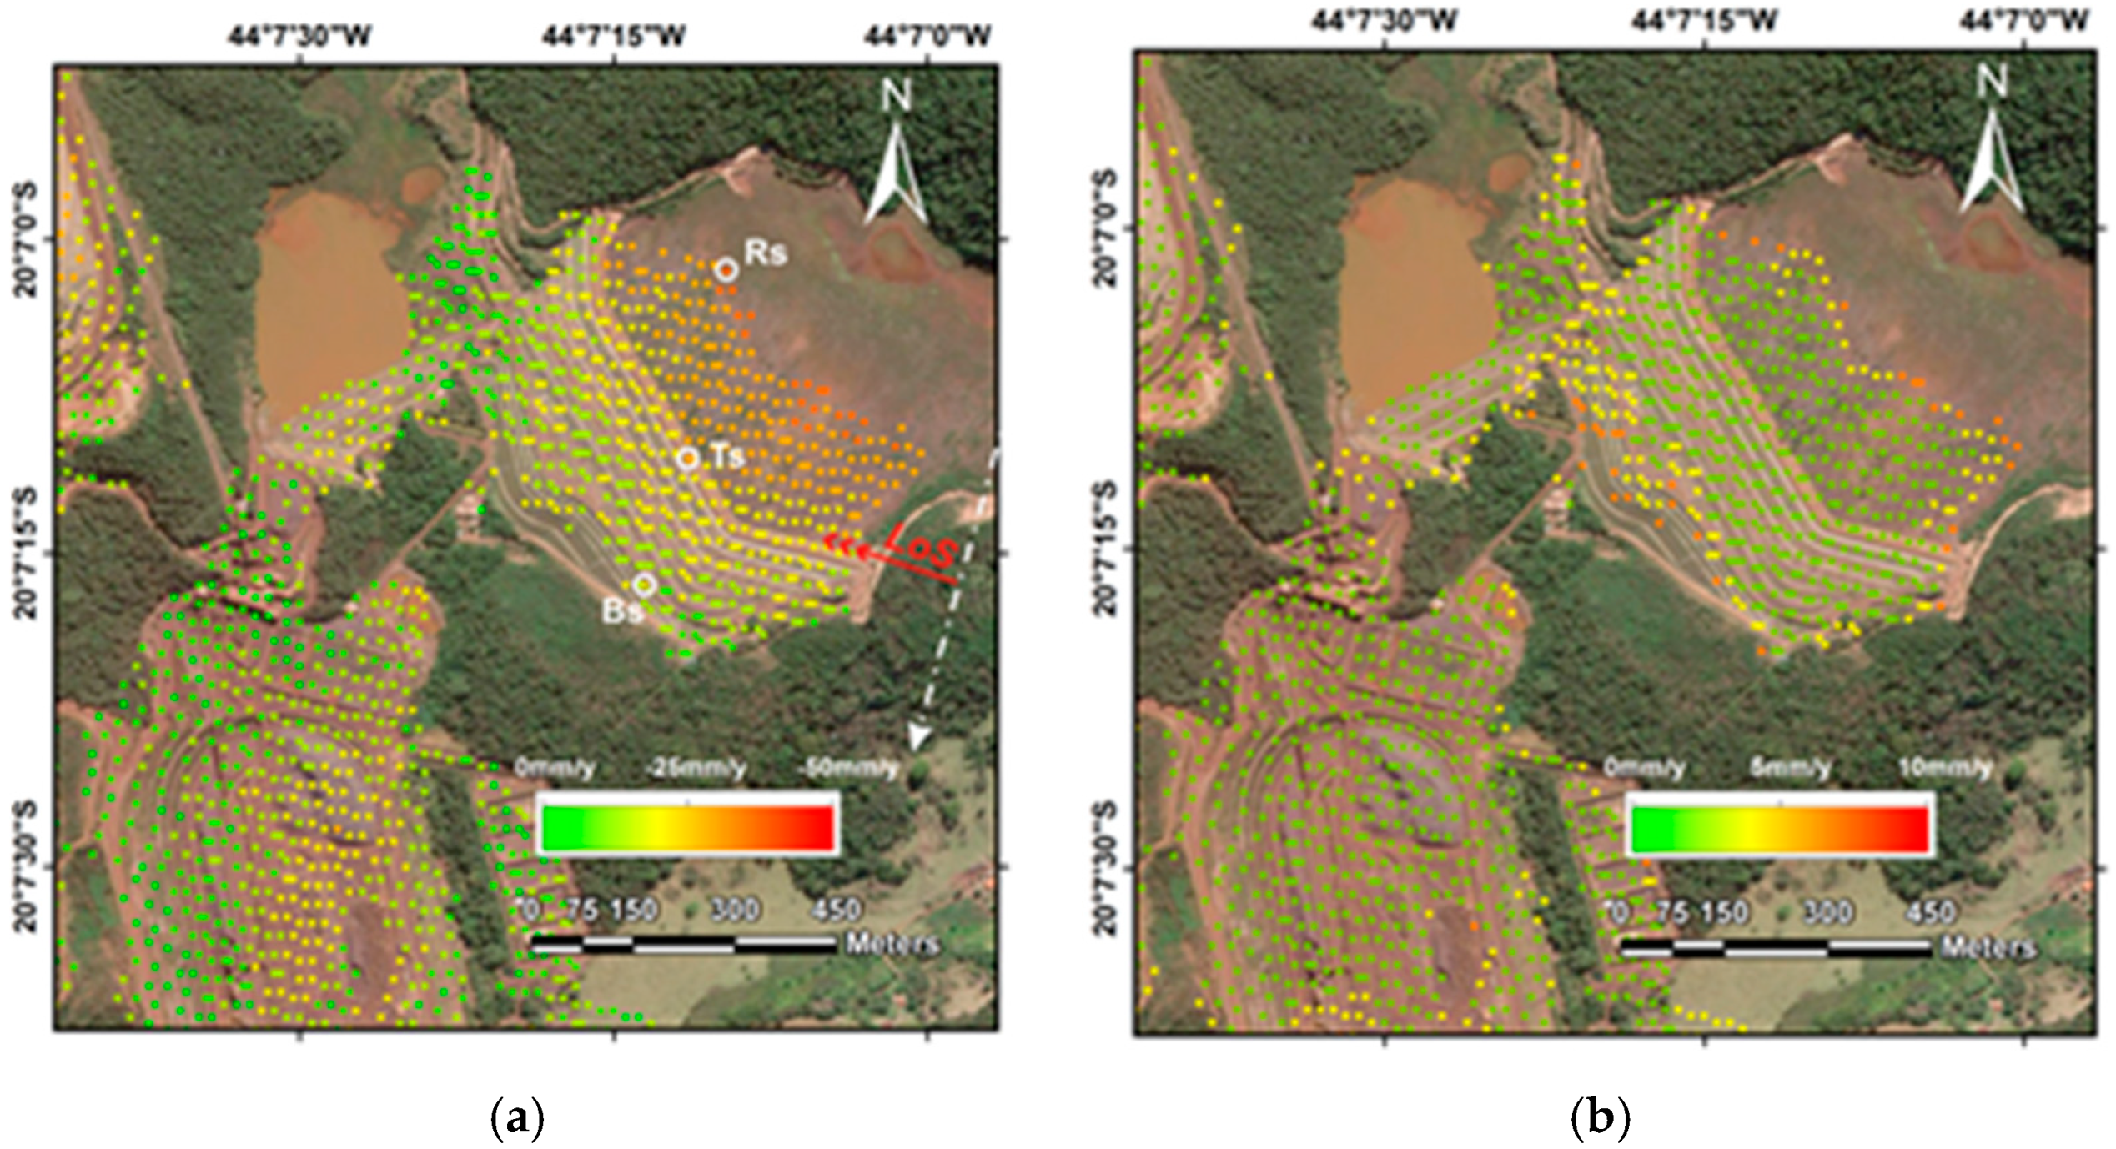
STUDY AREA
Figure 4 . Map of the displacement rate (a) and the standard deviation (b) from the SBAS analysis;
white circles represent the analyzed points in the dam reservoir (Rs), crest (Ts) and bottom face (Bs)

Slide 16
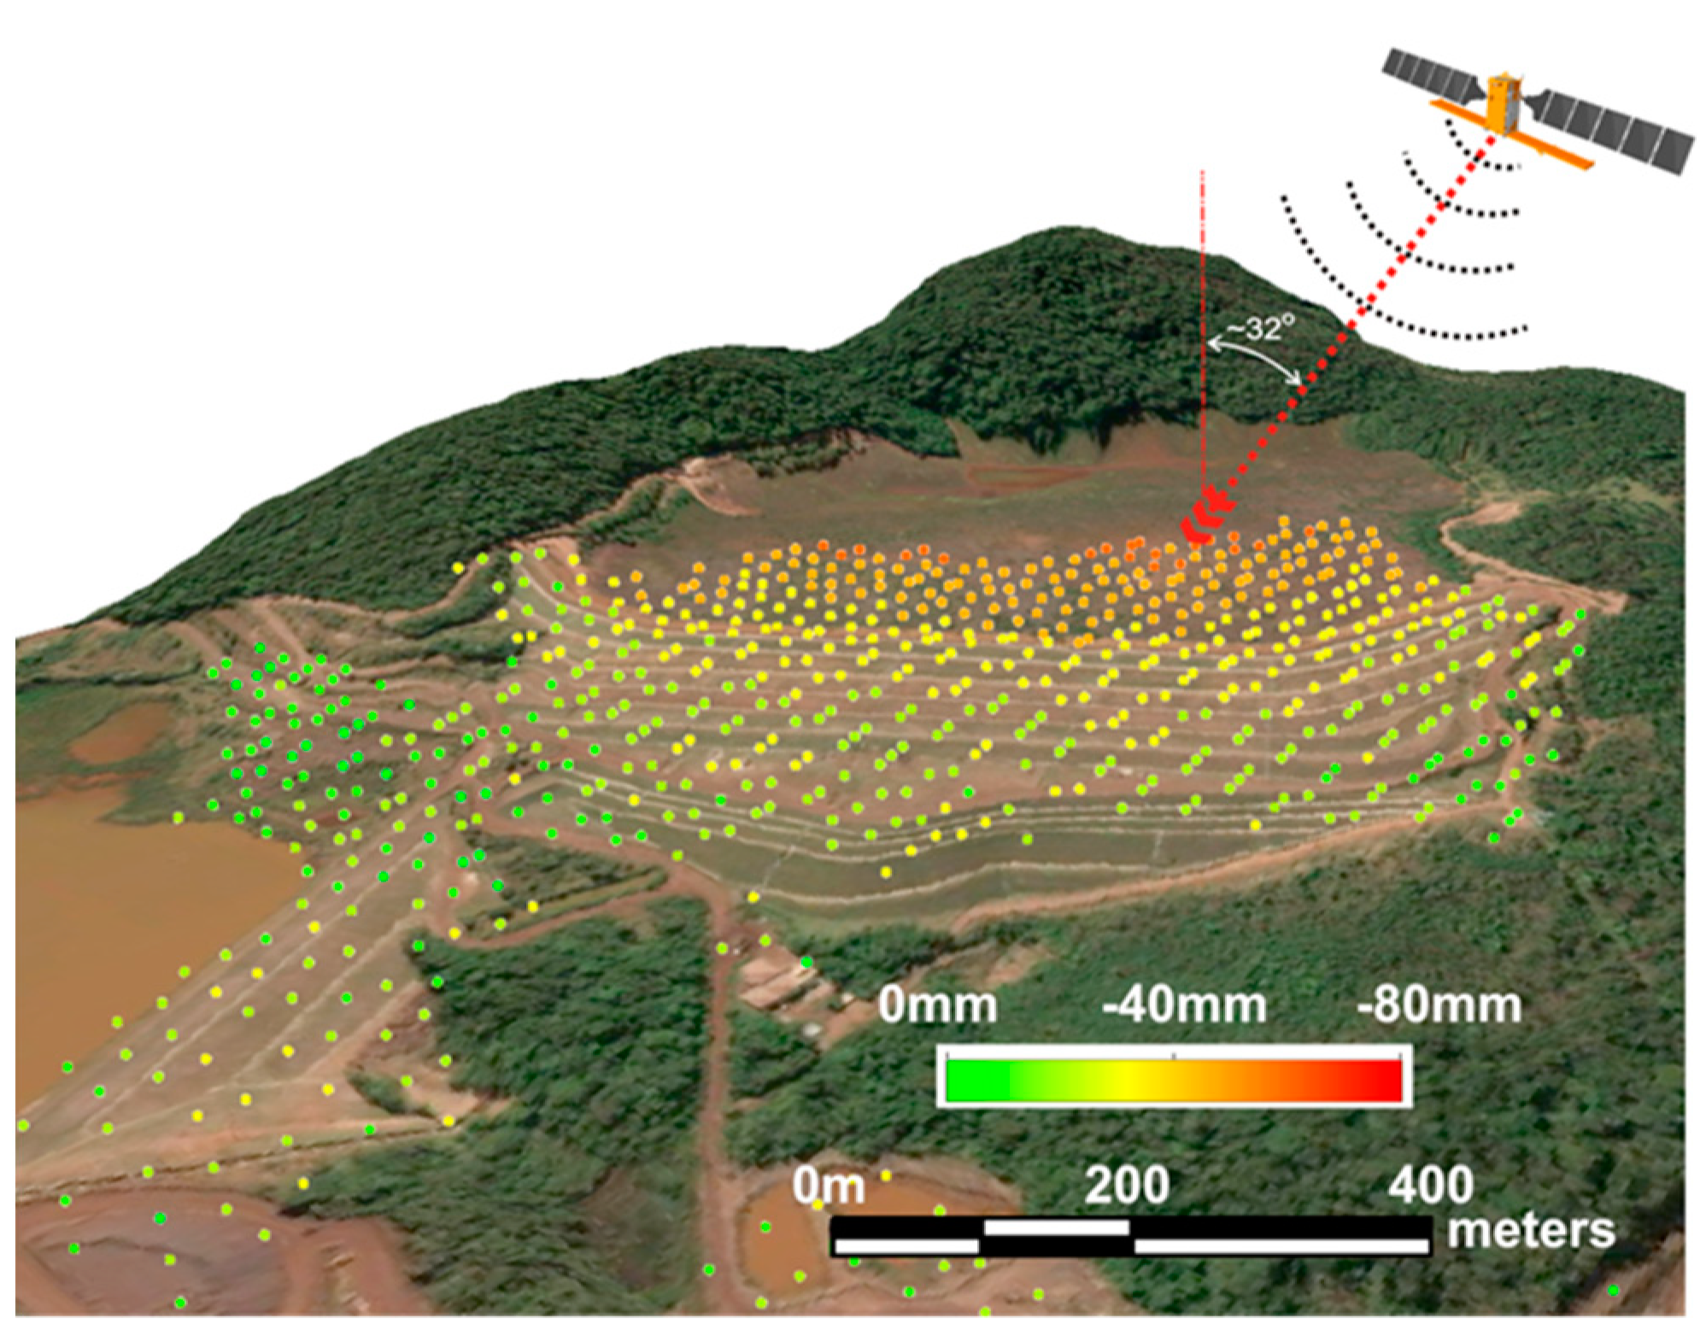
Figure 5. 3D view of Dam-I showing the accumulated displacement from SBAS processing analysis represented by colored dots.

Slide 17
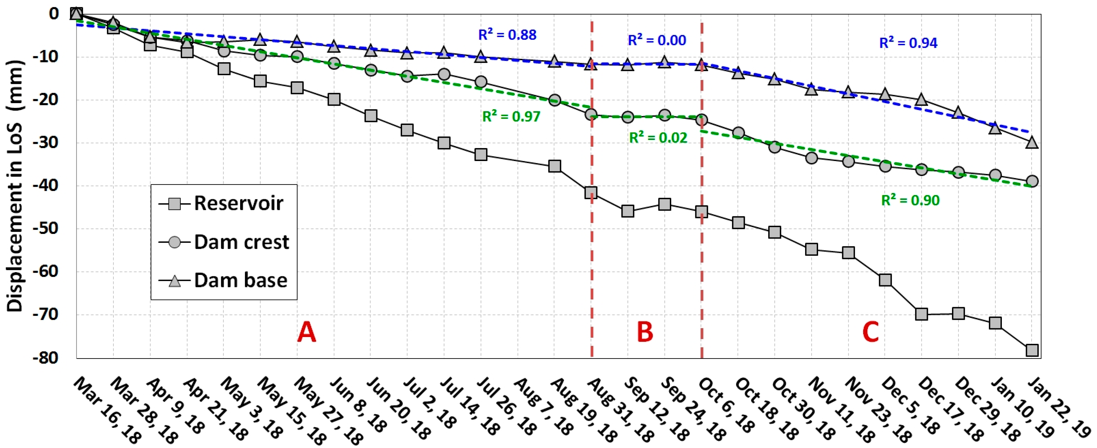
TIME SERIES
Figure 6. Time-series of SBAS line of sight (LoS) displacements for selected measured points (MPs) located at three selected points of the dam, as presented in Figure 5a, showing the highest cumulative displacements for the entire period of monitoring and the linear regression of the data (letters A, B,and C are the displacement trends as discussed in the text)

Slide 18
Reference-Geodetic and Remote-Sensing Sensors for Dam Deformation Monitoring
Deformation measurement; D-InSAR; GNSS(Global Navigation satellite systems); ground-based SAR; integrated
Monitoring systems; terrestrial laser scanning.
Which Are the Types of Deformations to be Measured in Dams?
Hydrostatic water pressure from the basin
The change in the strain-stress curve of the structural materials (e.g., due to plasticity processes)
Local sinking or sliding of the dam body with respect to the bedrock, Fluctuations of the ground settlements due to
the lowering and lifting of the water table.
These indirect impact on the structural and operational conditions of the dam itself.

Slide 19
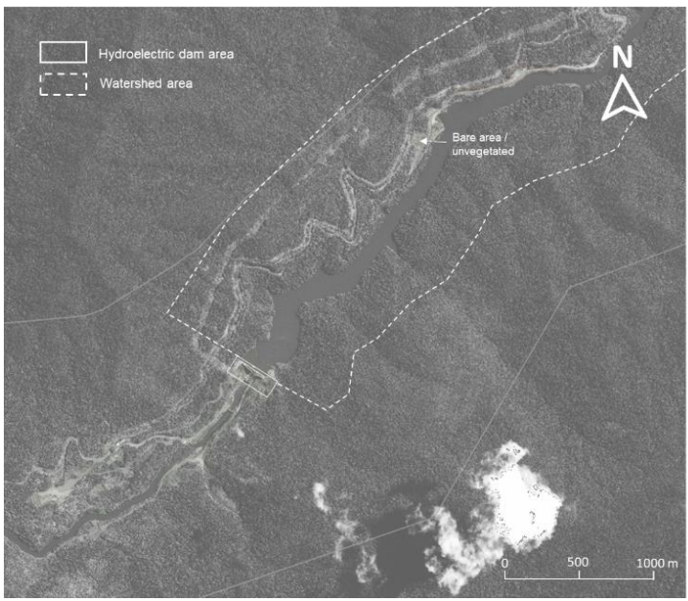
Slope Stability Monitoring of Hydroelectric Dam and Upstream Watershed
Areas Utilizing Satellite Interferometric Synthetic Aperture Radar (InSAR)
InSAR technology using a study case from one of the dams in Indonesia.
The dataset used in this work consists of 392 images of Sentinel-1 from 1 September 2018 to 11 August 2023
Slope deformation around dams and their watersheds .
Figure -The optical satellite imagery as basemap of the InSAR data for deformation analysis. The area of concern is divided into two main areas: dam and watershed area.

Slide 20
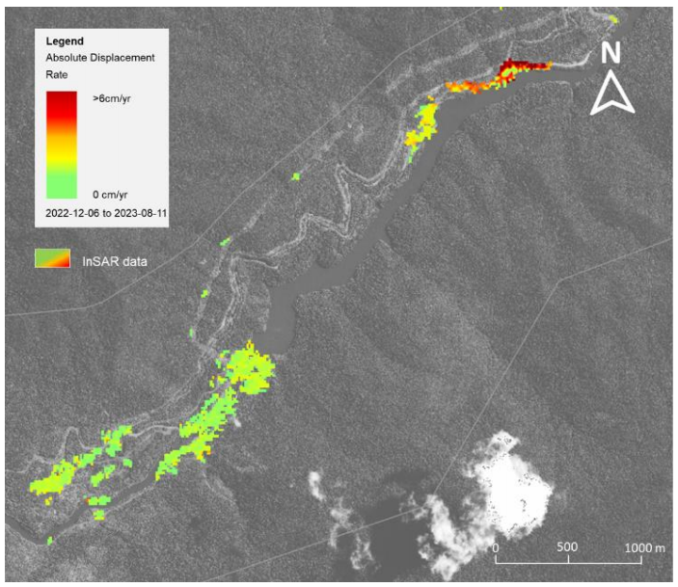
STUDY AREA
Figure - The deformation map of InSAR Sentinel-1 data (ascending and descending) from June 2022 to August 2023 at the study area. The red color
indicates a ground movement > 6cm / year, while
green shows stable behaviour or no deformation
observed.

Slide 21
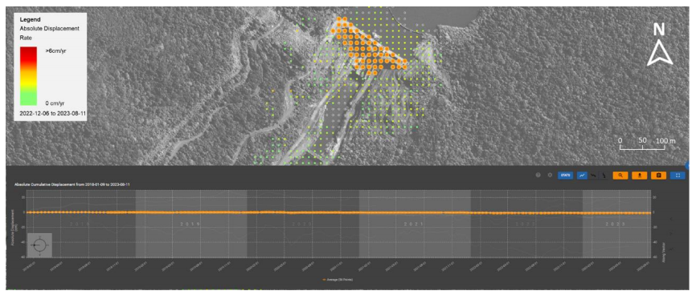
InSAR Deformation Analysis at Dam Area
Figure - Satellite InSAR Sentinel-1 data was acquired in ascending and descending geometry
over the dam area. The time series data shows a stable behaviour of the dam.

Slide 22
InSAR Deformation Analysis at Dam Area
Figure - Satellite InSAR Sentinel-1 data was acquired in ascending and descending geometry
over the dam area. The time series data shows a stable behaviour of the dam.

Slide 23
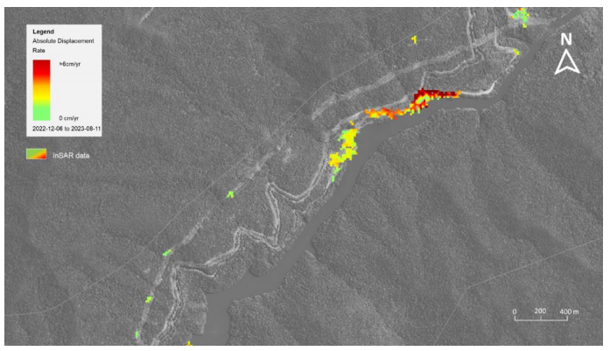
InSAR Deformation Analysis at watershed area
Figure - Deformation map of the watershed area. The red colour indicates a ground movement. There are no InSAR Sentinel-1 pixel data around the densely vegetated area

Slide 24
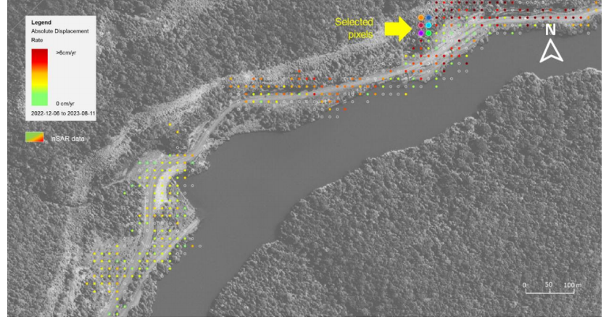
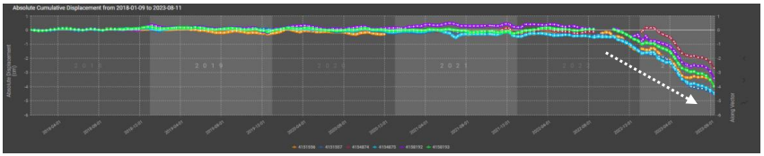
Figure a. Satellite InSAR Sentinel-1 data at the watershed area around the bare/unvegetated area. There are 6 pixels selected to analyse the time series.
Figure b. InSAR time series from the selected pixels around slopes near the road at the watershed area. Generally, linear deformation trends are observed around this area. Each colour indicates the selected pixel at figure a.

Slide 25
CONCLUSION
InSAR can help with dam safety
Surrounding Terrain and Slope Stability.
Monitoring Dam Structural Deformation
Early Warning and Risk Mitigation
Long-Term Monitoring and Historical Analysis
Reservoir Management

Slide 26
Reference -
Marco Scaioni-et-all 2018, Geodetic and Remote-Sensing Sensors for Dam Deformation Monitoring http://www.mdpi.com/journal/sensors
Fábio F. Gama 1-et-al 2020,Deformations Prior to the Brumadinho Dam Collapse
Revealed by Sentinel-1 InSAR Data Using SBAS and PSI Techniques,
goff-et-al-2021-satellite-data-for-dam-safety-monitoring, https://doi.org/10.1680/jdare.21.00021
Rahardian Dwitya- et-al 2024, IOP Conf. Ser.: Earth Environ. Sci. 1339 012037
Slope Stability Monitoring of Hydroelectric Dam and Upstream Watershed Areas Utilizing Satellite
Interferometric Synthetic Aperture Radar (InSAR)

Slide 27
THANK YOU

